Slide 1
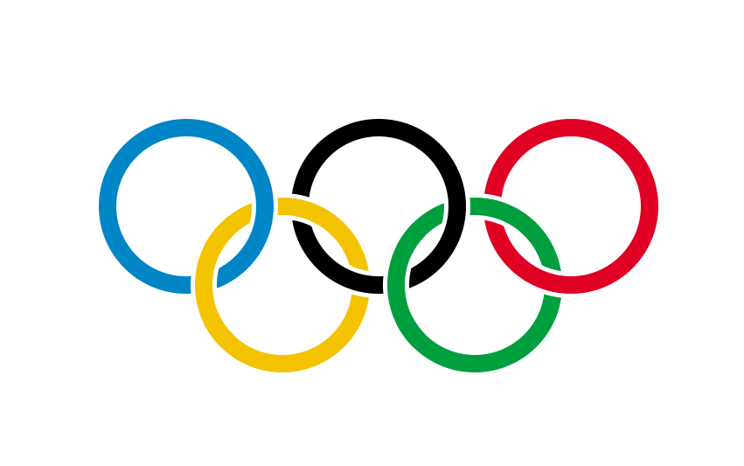
EXPLORATORY DATA ANALYSIS
SUMMER OLYMPICS DATASET

Slide 2
INFORMATION ON DATASET
This dataset contains information on the medals won by different athletes from different countries in the Summer Olympics events.
Information is from the year 1896 to 2012.
A total of 147 countries have won medals at Summer Olympics.
Till 2012, 666 distinct events were organized under 67 different disciplines.
22762 athletes have won medals at least once in 43 different sports.
Best Olympian under Men’s category is Michael Phelps(22 medals).
Under women’s category, Larisa Latynina is topping the chart with 18 medals.

Slide 3
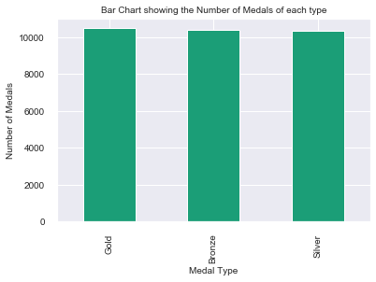
STUDY OF MEDALS
From the bar graph, we can see that the number of gold medals is the highest followed by bronze. Exact count is below:
Silver – 10310
Bronze – 10369
Gold - 10484

Slide 4
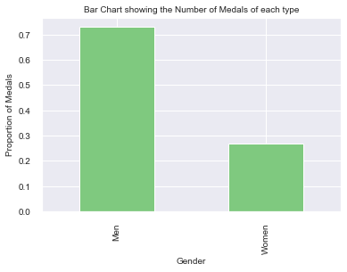
NUMBER OF MEDALS GENDER WISE
Of the given dataset, it is clear that males have won around 72% of the total medals while females are at 28%.

Slide 5
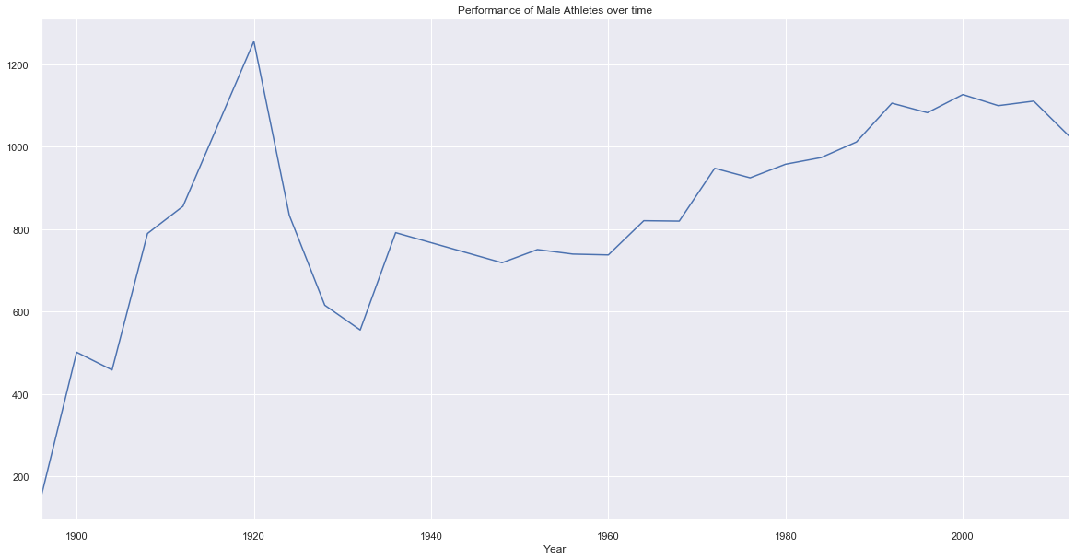
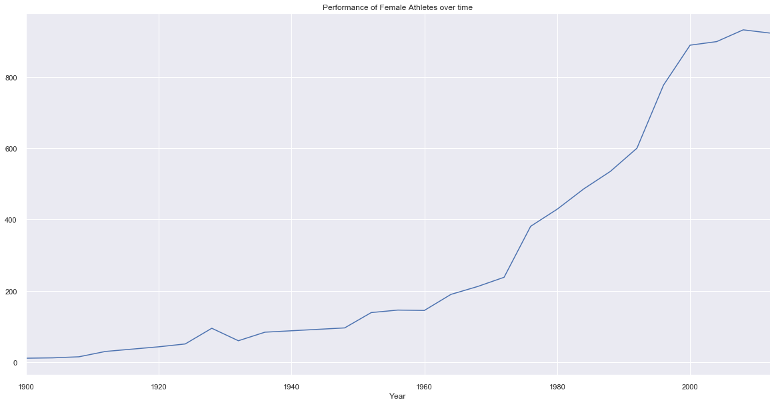
PERFORMANCE OF MEN vs WOMEN
The growth for men considering the medal tally looks less strong over the years.
We have a steep increase in the medal tally for women. Women tend to perform better over the years.

Slide 6
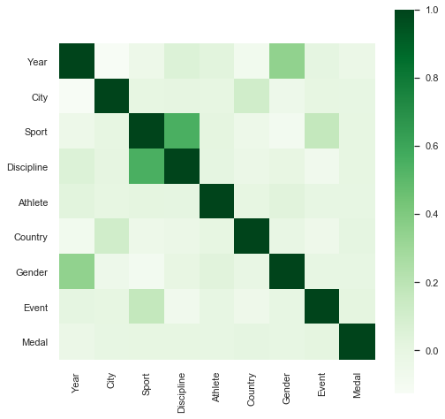
CORRELATION OF FEATURES
Sport and discipline are highly correlated.
Also, we see a mild positive correlation between Gender(Men is labelled as 0, Women is labelled as 1) and Year(1896 is labelled as 0 and so on) which we had discussed in the previous slide. This is one of the evidence that performance of women were better than man over the years.

Slide 7
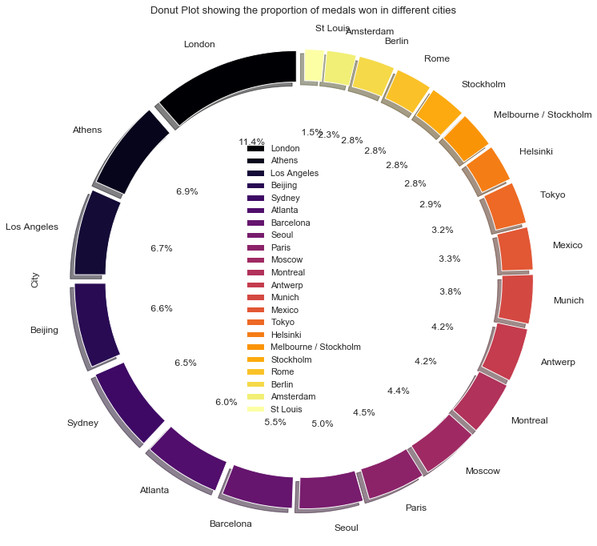
DISTRIBUTION OF MEDALS CITY WISE
From the above pie chart, it is quite evident that most number of medals have been won at London followed by Athens, Los Angeles, Beijing and so on.

Slide 8
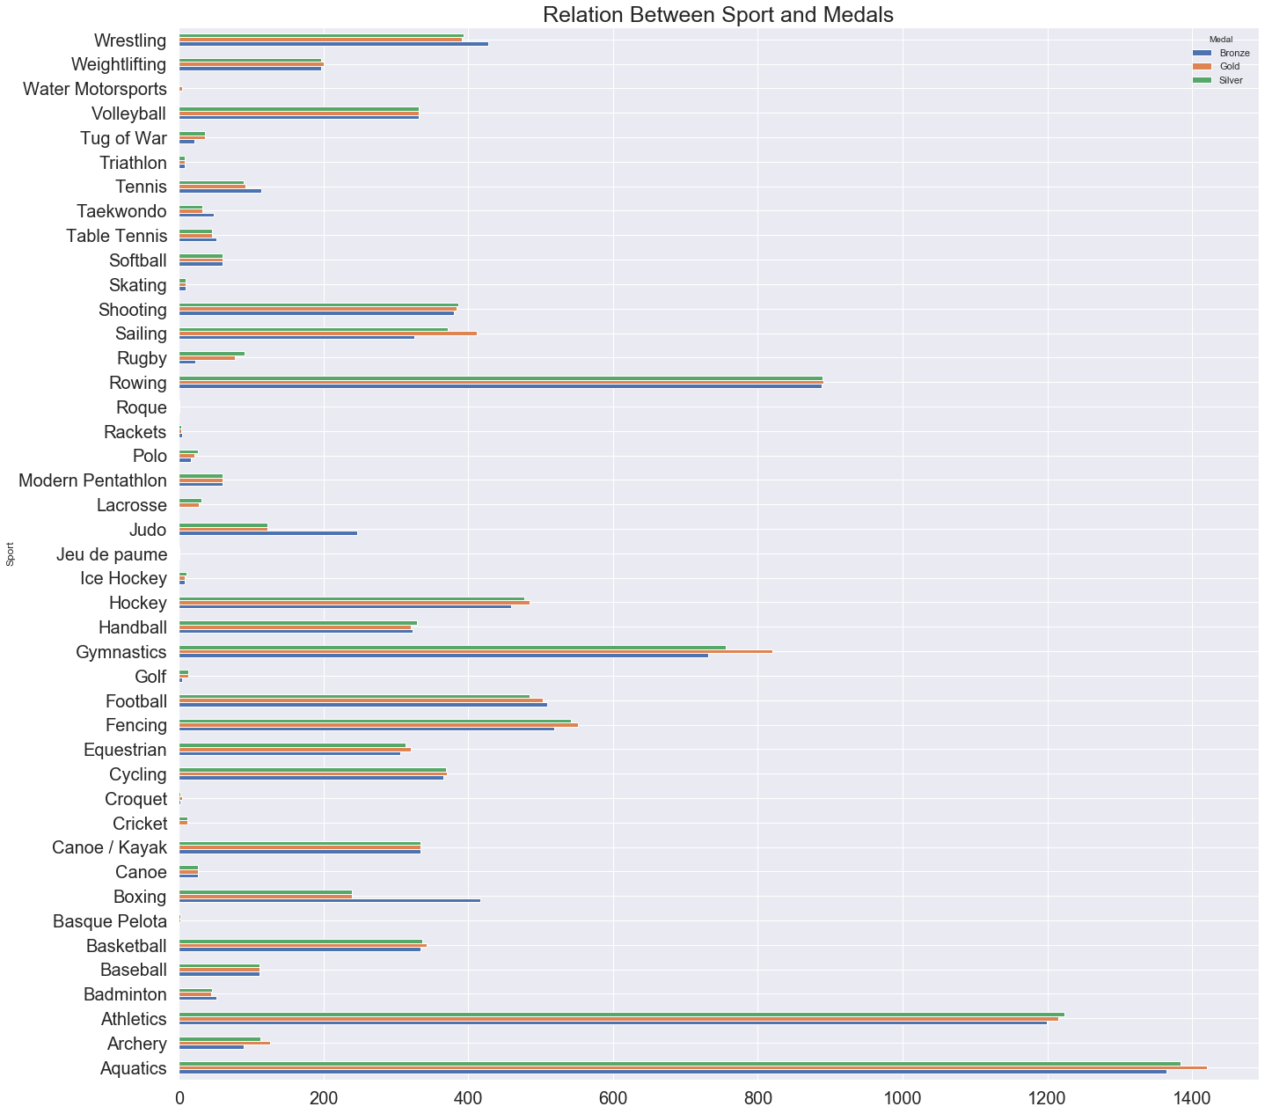
DISTRIBUTION OF MEDALS ACROSS VARIOUS SPORTS
1. Number of medals is highest in Aquatics sport segments. This may imply that aquatics hold many events or
aquatics is present in Olympics since a long time.
2. After aquatics, number of medals is highest in Athletics, followed by Rowing, Gymnastics and so on.

Slide 9
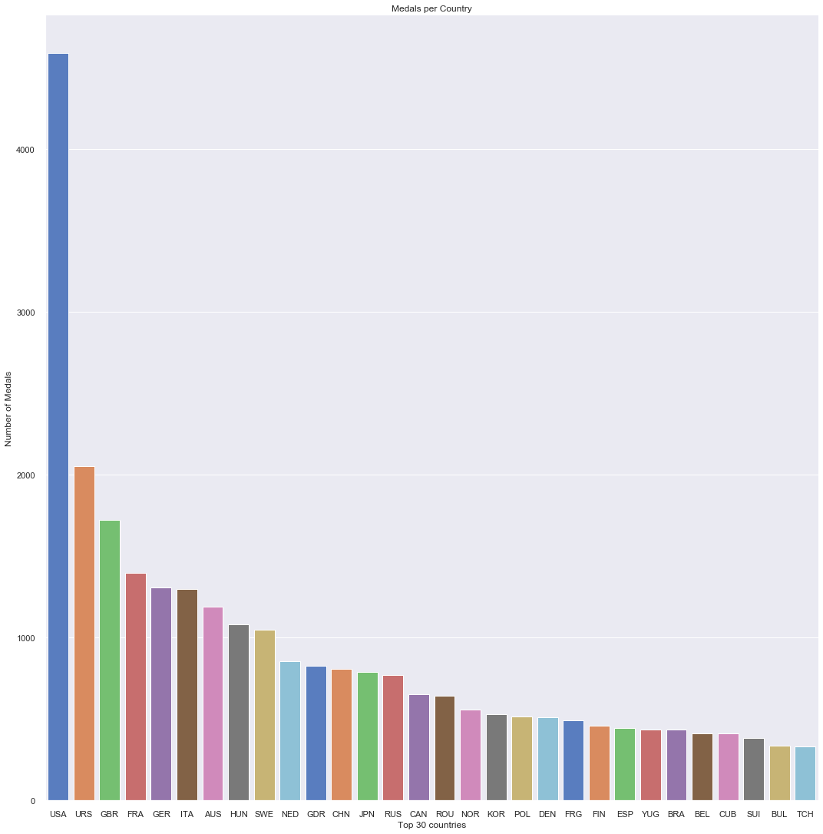
ANALYSIS ON MEDALS WON BY COUNTRIES

Slide 10
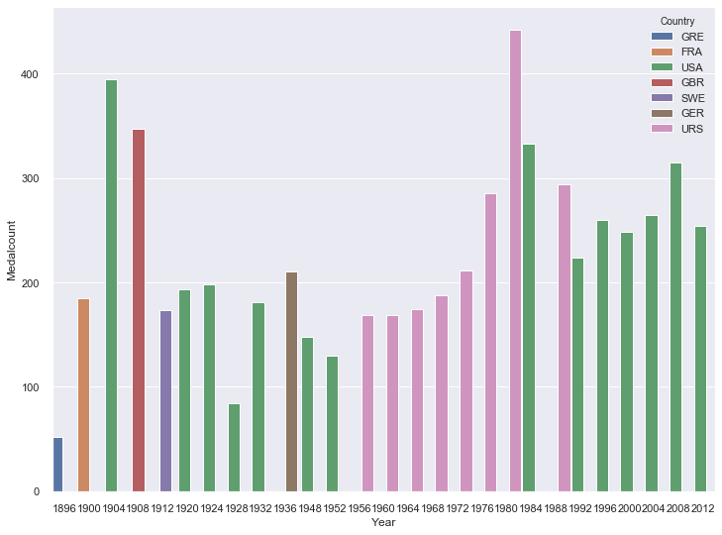
BEST PERFORMING NATION AT VERY OLYMPICS
USA(green bar) is the top performing country most of the time.
URS(Soviet Union) represented by magenta bar had been exceptional performers during 1956 to 1980.

Slide 11
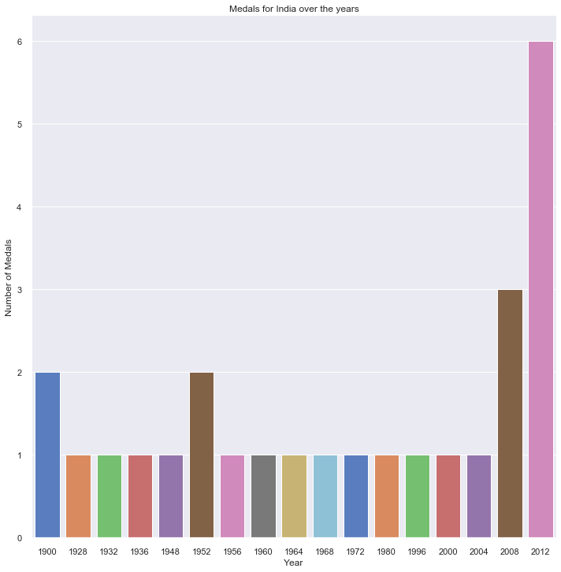
INDIA AT SUMMER OLYMPICS
Best performance of India came in 2012 London Olympics where Indians clinched 6 medals.
India has been quite impressive in Hockey grabbing gold medal many times(1928 to 1968).

Slide 12
CONCLUSION & ACTIONABLE INSIGHTS
CONCLUSION:
From slide 5, it is evident that performance of women were better than that of men over the years.
Overall, USA has been the best performing nation at Olympics till 2012.
Olympics did not happen during world wars in the year 1916, 1940 and 1944.
Most number of medals have been won at London. This is true as London has hosted Olympics most(thrice), followed by LA(2 times).
Medal counts depends largely on economical factors. USA being most developed nation is on the top in most of the Olympics. Soviet Union were unbeatable during 1950s-80s. However, disintegration of USSR affected a lot in Olympics also.
ACTIONABLE INSIGHTS:
Of the given dataset, it is clear that males have won around 72% of the total medals while females are at 28%. However, when we consider performance, women’s graph tend to be more increasing than me(From slide 5). International Olympics Committee should organize more events for women as they have exhibited better potential.
Most number of medals have been won in Aquatics segment followed by Athletics and Rowing. This in turn means that most number of events are organized in these sports. Many countries which have not done fairly well should concentrate on these areas as the chances of them getting a medal will increase by doing so.
India have done fairly well in Hockey and Shooting. India has immense talent in these 2 areas and more focus can be given here by Indian authorities.

